Slide 1
Media resources: sex trafficking
Videos, Poems, Songs, and Artwork

Slide 2
Video 1: “I Was Sex Trafficked for Years; Brothels are Hidden in Plain Sight,” Casandra Diamond, TEDx Toronto
https://www.ted.com/talks/casandra_diamond_i_was_sex_trafficked_for_years_brothels_are_hidden_in_plain_sight

Slide 3
Video 2: OBLIVIOUS (A Short Film about Sex Trafficking), dir. Mikey Hardesty A film for SHIFT freedom (SHIFTFREEDOM.org) https://www.youtube.com/watch?v=zpebw_yBoZg

Slide 4
Poem 1: “Sex Trafficking Incidents in the Life of a Slave Girl in the USA (or, The Nation’s Plague in Plain Sight),” Evie Shockley
https://www.poetryfoundation.org/poems/147035/sex-trafficking-incidents-in-thelife-of-a-slave-girl-in-the-usaor-the-nations-plague-in-plain-sight

Slide 5
Poem 2: “Street Corner,” Jessie Gray https://powerpoetry.org/POEMS/STREET-CORNER (from Power Poetry, the world’s first and largest mobile poetry community for youth.)

Slide 6
Song 1: “All God's Children,” Tauren Wells https://www.youtube.com/watch?v=Ilp2Pw_mpSM

Slide 7
Song 2: “Don't Walk Away (Human Trafficking Song),” Meg Ammons https://www.youtube.com/watch?v=VAhKtNdWisE

Slide 8
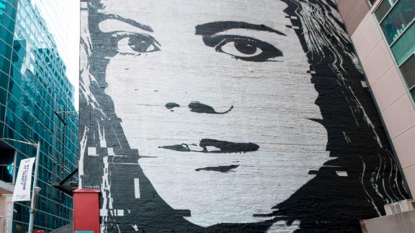
Artwork 1:
Street Art for Mankind (SAM)
CNN article about SAM: ”New York Street Art Shines a Light on Human Trafficking”

Slide 9
Artwork 2: “Tethered,” Pamela Alderman Part of the exhibit, the Scarlet Cord READ MORE about the exhibit: Phoenix Art Exhibit Shines Light on Child Sex Trafficking

