Slide 1
Media resources: technology privacy
Videos, Songs, Poems, and Artwork

Slide 2
Video 1: “When Technology can read minds, how will we protect our privacy?” – nita farahany, Ted talk
https://www.ted.com/talks/nita_farahany_when_technology_can_read_minds_how_will_we_protect_our_privacy?language=en

Slide 3
Video 2: “ONLINE PRIVACY: IT DOESN’T EXIST: Privacy and what we can do about it,” Denelle Dixon, TEDxMarin https://www.youtube.com/watch?v=LgWrD3EJ1Do

Slide 4
Song 1: “Metal,” Gary Newman https://www.youtube.com/watch?v=kLfz2bbxxuM

Slide 5
Song 2: “Digital Witness,” St. Vincent https://www.youtube.com/watch?v=mVAxUMuhz98

Slide 6
Poem 1: “Webcam poetry,” Joe McAlister https://joemcalister.com/webcam-poetry/

Slide 7
Artwork 1: "The Public Private," Curated by Christiane Paul https://gadgets.ndtv.com/internet/news/art-exhibit-pushes-boundaries-of-online-privacy-352419

Slide 8
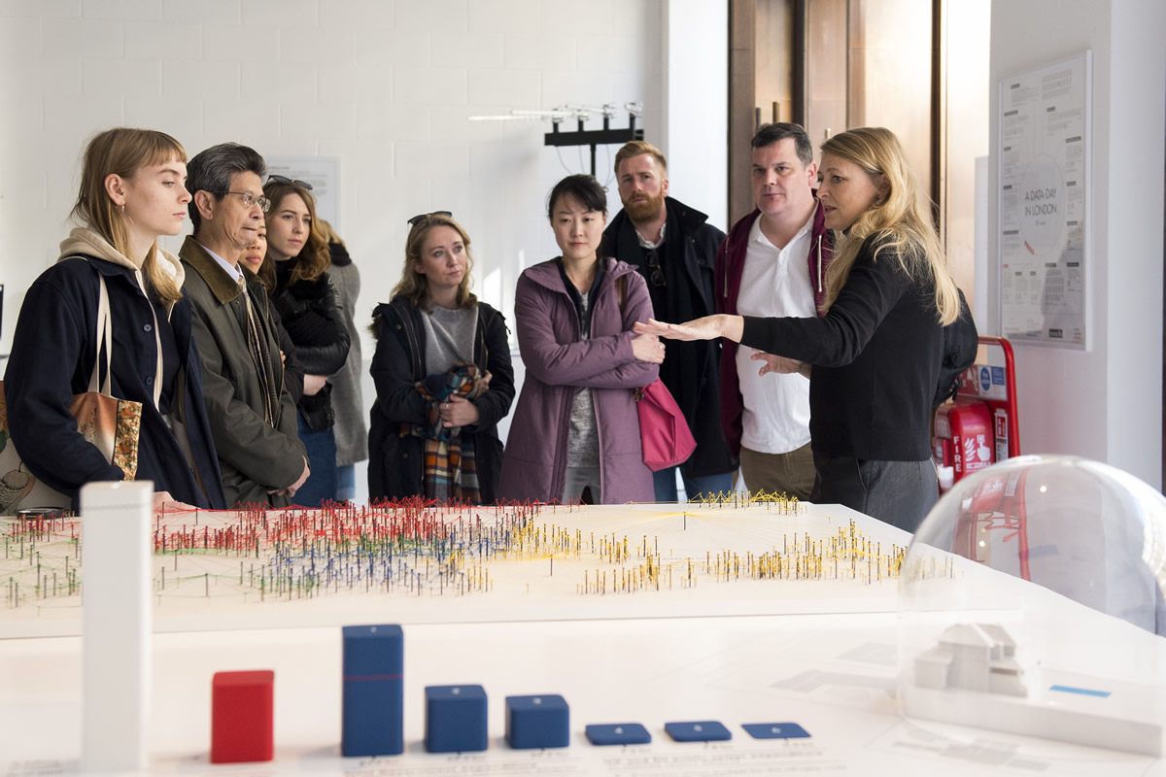
Artwork 2: “The Glass Room: Big data, privacy and interactive art,” Alistair Alexander, Project Lead
The Glass Room brings together art, technology and the aesthetics of consumer retail. Visitors are presented with political questions about the data we share online with or without our knowledge. The exhibition creates a welcoming and accessible space that enables visitors to question their own assumptions about their digital lives and data, and to explore difficult and suppressed questions about their online activities.
https://mobilisationlab.org/stories/big-data-privacy-interactive-art/

