Slide 1
Media Resources: Texting and Driving
Videos, Songs, and Artwork

Slide 2
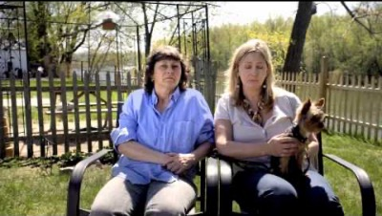
Video 1:
“ From One Second to the Next,”
Werner Herzog https://www.youtube.com/watch?v=Xk1vCqfYpos

Slide 3
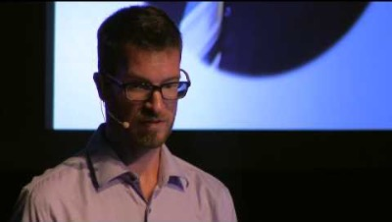
Video 2:
”The Risks of Distracted Driving,”
Brad Gorski,
TED Talk https://www.youtube.com/watch?v=ucPJm_zNwio

Slide 4
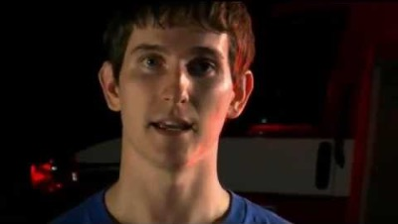
Song 1:
“It Can Wait,” Travis Tucker https://www.youtube.com/watch?v=VFmQNjbFEFY

Slide 5
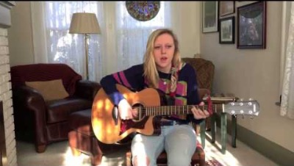
Song 2:
“Halfway Home,”
Emma Badams https://www.youtube.com/watch?v=whtbA7ywaQk

Slide 6
A reverse poem of the preventable killer of teens: distracted driving by Erika A https://createrealimpact.com/entries/24967/
Texts, posts, and emails are worth my life while driving.
You’ll never hear me say
Seatbelts are important.
I also believe
It’s okay to answer a text as long as I look at the road often.
It’s ridiculous to think
I can miss my favorite celebrity’s Instagram Live one time
And that I should wait to drink my bubble tea until I get home
I know
I don’t have a higher risk of dying if I drive with my phone in one hand as long as the other is on the wheel.
So, it’s naive to say
Multitasking is impossible.
I won’t be endangering others if I check Twitter quickly
And it’s untrue when I say
Driving distracted kills 11 teens every day.
Everybody should know that
There’s harm in waiting to do your makeup.
Nobody could convince me that
It’s a choice to drive distracted.

Slide 7
https://adowel37.wordpress.com/2010/05/16/texting-while-driving-poem-written-by-carolyn-vannoster/
The First Poem
Carolyn Vannoster
You think it’s not a big deal
You’ve been driving several years
But have you really thought about
The cause of many tears
What if…….for just an instance
Your eyes have left the road
Your hands were busy TEXTING
And your mind was in THAT mode
It only takes a second
To make a fatal mistake
And once that it has happened
The consequences are hard to take
You say that it won’t happen to me
I’m ALWAYS in control
But what about the time it did
Was it worth the life you stole?
So keep your phone out of arms reach
Until you’ve reached your destination
YOU are responsible for your actions
Driving deserves your concentration
Must it always take disaster?
To open up our eyes
Please teach by your example
Before more of America dies….

Slide 8
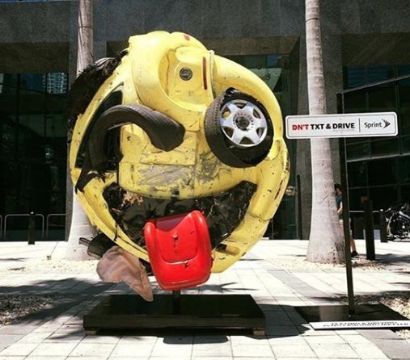
Artwork 1: “The Last Emoji,” Rudolf Kohn
(fashioned from car wreckage)

Slide 9
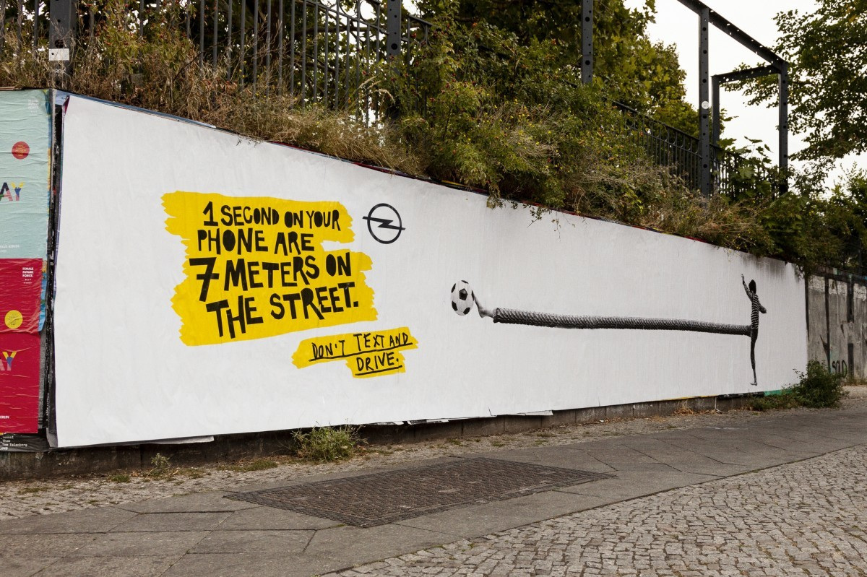
Artwork 2:
“Seven Meters,”
Lukas Kolling

