Slide 1
Media resources: mental health of ________ [you can choose, but for our purposes here, I’ve chosen teens]
Videos, Poems, Songs, and Artwork

Slide 2
Video 1: “Why students should have mental health days,” Hailey Hardcastle, TED TALK
"Why Students Should Have Mental Health Days"

Slide 3
Video 2: “Teen Health: Mental Health,” Penn State PRO Wellness: https://www.youtube.com/watch?v=1i9OktVsTWo

Slide 4
Video 3: “Tales from a teenage mental health advocate,” Amanda Southworth, TEDxPasadena https://www.youtube.com/watch?v=pLOagmZTWmM

Slide 5
Song 1: “Hunger,” Florence + the Machine
https://www.youtube.com/watch?v=5GHXEGz3PJg

Slide 6
Song 2: “1-800-273-8255,” Logic ft. Alessia Cara, Khalid
https://www.youtube.com/watch?v=Kb24RrHIbFk

Slide 7
Song 3: “Breathe me,” Sia
https://www.youtube.com/watch?v=ghPcYqn0p4Y

Slide 8
Song 4: “Pennyroyal tea,” Nirvana
https://www.youtube.com/watch?v=4dcIPGzxsl8

Slide 9
Poem 1: “The Soul Has bandaged moments,” Emily dickinson
The Soul has Bandaged moments – When too appalled to stir – She feels some ghastly Fright come up And stop to look at her –
Salute her, with long fingers – Caress her freezing hair – Sip, Goblin, from the very lips The Lover – hovered – o’er – Unworthy, that a thought so mean Accost a Theme – so – fair –
The soul has moments of escape – When bursting all the doors – She dances like a Bomb, abroad, And swings opon the Hours,
As do the Bee – delirious borne – Long Dungeoned from his Rose – Touch Liberty – then know no more, But Noon, and Paradise –
The Soul’s retaken moments – When, Felon led along, With shackles on the plumed feet, And staples, in the song,
The Horror welcomes her, again, These, are not brayed of Tongue –

Slide 10
Poem 2: “Little Stones at My Window,” Mario Benedetti
for roberto and adelaida
Once in a while
joy throws little stones at my window
it wants to let me know that it's waiting for me
but today I'm calm
I'd almost say even-tempered
I'm going to keep anxiety locked up
and then lie flat on my back
which is an elegant and comfortable position
for receiving and believing news
who knows where I'll be next
or when my story will be taken into account
who knows what advice I still might come up with
and what easy way out I'll take not to follow it
don't worry, I won't gamble with an eviction
I won't tattoo remembering with forgetting there are many things left to say and suppress
and many grapes left to fill our mouths
don't worry, I'm convinced
joy doesn't need to throw any more little stones
I'm coming
I'm coming.

Slide 11
Poem 3: “The Rider,” Naomi shihab nye
A boy told me
if he roller-skated fast enough
his loneliness couldn’t catch up to him,
the best reason I ever heard
for trying to be a champion.
What I wonder tonight
pedaling hard down King William Street
is if it translates to bicycles.
A victory! To leave your loneliness
panting behind you on some street corner
while you float free into a cloud of sudden azaleas,
pink petals that have never felt loneliness,
no matter how slowly they fell.

Slide 12
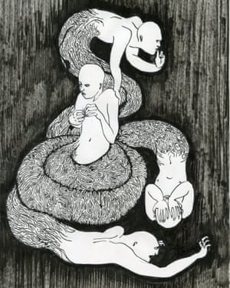
Artwork 1: “At the Bottom of the Anxiety Swamp,” Jayoon Choi from The perspective project

Slide 13
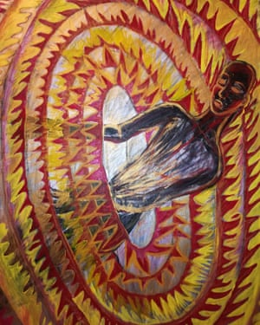
Artwork 2: “Your Pain Is My Pain,” Paula Scotter from the perpsective project

