Slide 1
Media Resources for commercial Fishing
Videos, Songs, Poems, and Artwork

Slide 2
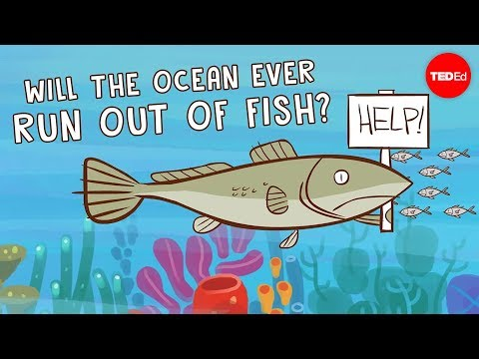
Video 1: Will the ocean ever run out of fish? - Ayana Elizabeth Johnson and Jennifer Jacquet

Slide 3
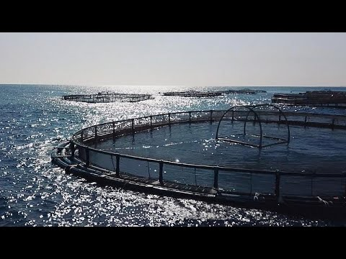
Video 2: Wild vs farmed fish: what should you choose? By Euronews’ Denis Loctier

Slide 4
Song 1: Talking Fishing Blues - Woody Guthrie

Slide 5
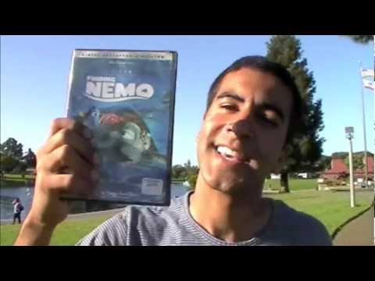
Song 2: Overfishing Rap

Slide 6
Poem 1: The Women Who Clean Fish by Erica Funkhouser
The women who clean fish are all named Rose
or Grace. They wake up close to the water,
damp and dreamy beneath white sheets,
thinking of white beaches.
It is always humid where they work.
Under plastic aprons, their breasts
foam and bubble. They wear old clothes
because the smell will never go.
On the floor, chlorine.
On the window, dry streams left by gulls.
When tourists come to watch them
working over belts of cod and hake,
they don't look up.

Slide 7
cont.
They stand above the gutter. When the belt starts
they pack the bodies in, ten per box,
their tales crisscrossed as if in sacrament.
The dead fish fall compliantly.
It is the iridescent scales that stick,
clinging to cheek and wrist,
lighting up hours later in a dark room.
The packers say they feel orange spawn
between their fingers, the smell of themselves
more like salt than peach.

Slide 8
Poem 2: The Call of the Stream by Charles Crandall
I am sitting to-day at the desk alone,
And the figures are hard to tame;
I'd like to shift to a mossy stone
Nor bother with pelf and fame.
I know a pool where the waters cool
Rest under the brawling falls,
And the song and gleam of that mountain stream —
Oh, it calls, and calls, and calls!
There are hooks and lines in a wayside store
Where the grangers buy their plug,
And the loggers swap their river-lore
For a jag they can hardly lug.
I wonder how long that tackle will lie
As useless as any dumb fool
Unless I happen along to buy,
And sneak for that mountain pool.

Slide 9
cont.
Oh, bother the flies, I guess I've enough,
I know where the worms are thick
By Billy's old barn — Oh, they are the stuff —
You can dig a quart with a stick.
The reel is all right and the line is tight,
And if they should happen to fail
There's little birch rods that are fit for gods
When they follow the trout-brook trail.
I jing! the demon has rung me up —
The "central" up in the woods —
Waders, and creel, and a pocket-cup!
I'm after the only goods.
Wire for Hank and the old buckboard —
The secret, I guess, is out —
Don't bother me now — you'll get in a row —
I'm catching the train for trout.

Slide 10
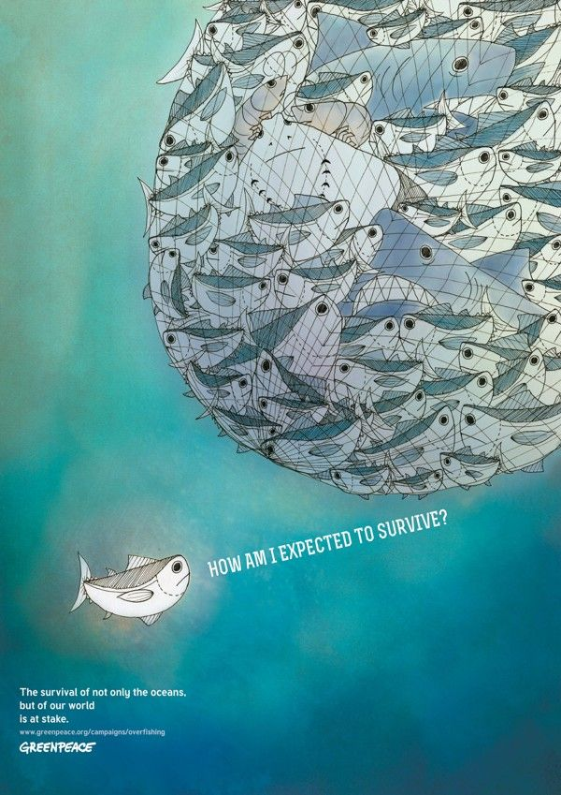
Artwork 1: Overfishing by Feliana Sutanto for greenpeace (2013)

Slide 11
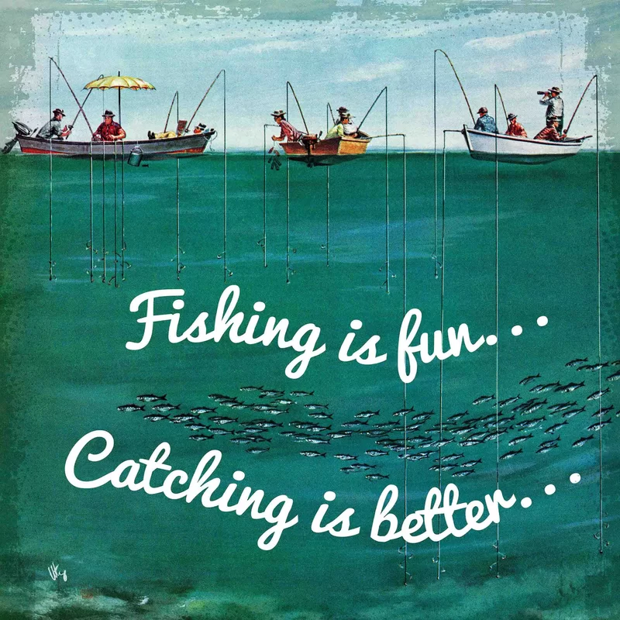
Artwork 2: School of Fish Among Lines by Thornton Utz (1954)

