Slide 1
Media Resources for Homelessness
Videos, Songs, Poems, and Artwork

Slide 2
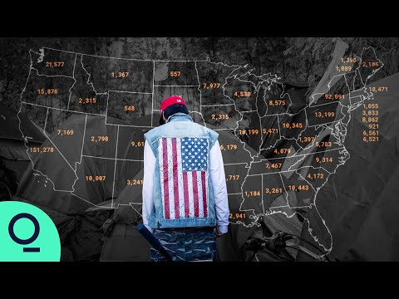
Video 1: How to Fix America's Worsening Homeless Crisis by Bloomberg CityLab

Slide 3
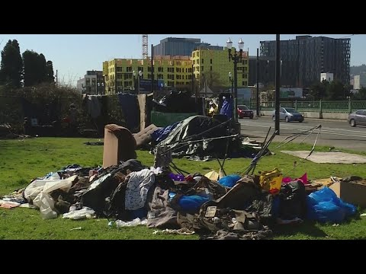
Video 2: City of Roses or City of Homeless? Portland's human tragedy by KOIN 6

Slide 4
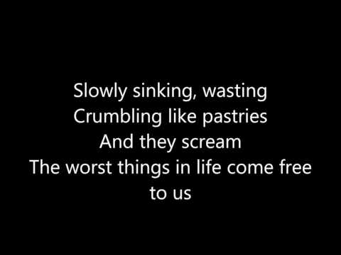
Song 1: The A Team by Ed Sheeran

Slide 5
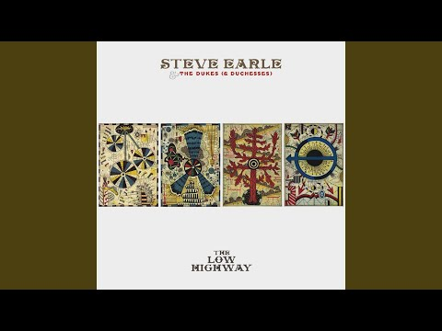
Song 2: Burnin’ It Down by Steve Earle

Slide 6
Poem 1: Homeless by Juliet Kono
My son lives on the streets.
We don’t see each other much.
Like a mother who puts white lilies
on the headstone of a dead child,
I put money into his bank account,
clothes into E-Z Access storage
and pretend he’s far away—
at a boarding school, or in a foreign country.
Nights, I dream fairy tales about him.
I dream he becomes a prince,
scholar or warrior who rescues me
from sorrow, the way he rescued me
when he was a child and said,
“Mommy, don’t cry,” and brought tea
into the room of his father’s acrimony—
brave, standing tall in the forest
fire of his father’s scorn.

Slide 7
I wake
to the empty sound of wind in the trees.
He says he wants to live with me.
I say I can’t live with him—
boy whose words crash like branches in a rain storm.
Nothing can hold him in,
the walls of a house too thin.
Back home, I had seen
the “study-hard-so-you-don’t-become-like-them”
street bums on Mamo Street,
and he’s like them.
These days, in order to catch a glimpse of him,
I circle the city. One day,
I see him on his bike.
People give him wide berth,
the same way birds avoid power lines,
oncoming cars or trees.
I park on a side street.
Wild-eyed, he flies the block
as if in a holding pattern.
Not of my body, not of my hopes,
he homes in on what can’t be given or taken away.

Slide 8
Poem 2: Me, Myself, and I by Jamie
Sat on the edge of society, Wonderin why am not a priority.
What’s come of my life an come over me, my life's in tatters can't you see.
Beggin at the bank everyday, get a job get a life people say.
I get no benefits, just what people give, to buy food + drink to help me live.
I live in the streets doorway's my bed, people think am thick in the head.
It's just me, myself and I, nobody wants me do you know why.
Don't deserve to live with a smile, to make my life worth the while.
Source: https://www.mirror.co.uk/news/uk-news/homeless-mans-devastating-poem-life-13750255

Slide 9
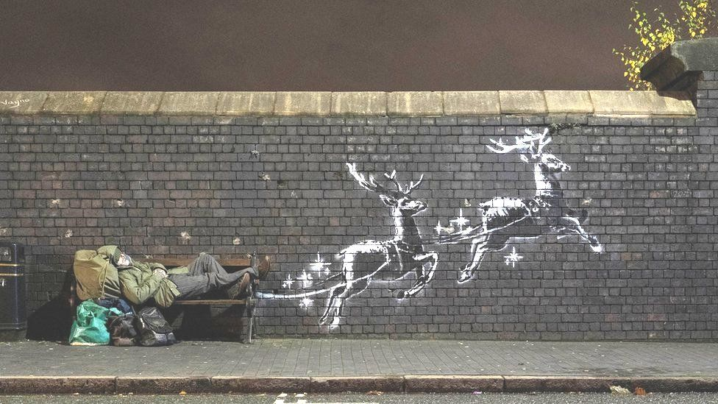
Artwork 1: God Bless Birmingham by Banksy

Slide 10
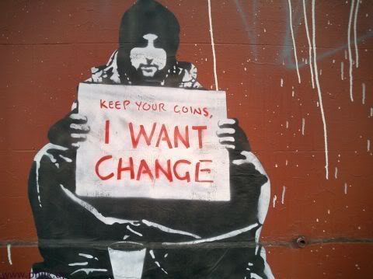
Artwork 2: I Want Change by Meek

