Slide 1
Student Loan Forgiveness/
Debt Reduction
Videos, Songs, Poems, and Artwork

Slide 2
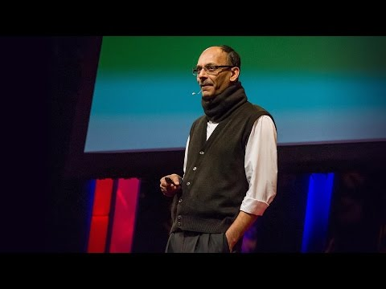
Video 1: How college loans exploit students for profit by Sajay Samuel

Slide 3
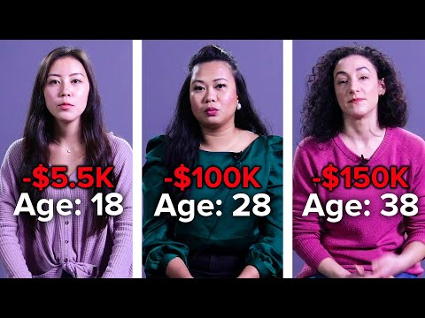
Video 2: 18 Vs. 28 Vs. 38: Student Loans

Slide 4
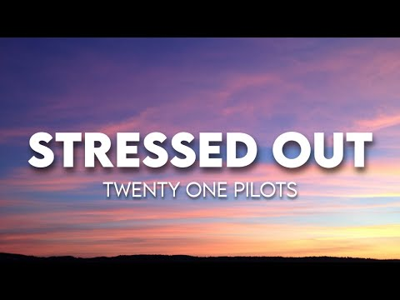
Song 1: Stressed Out by Twenty One Pilots

Slide 5
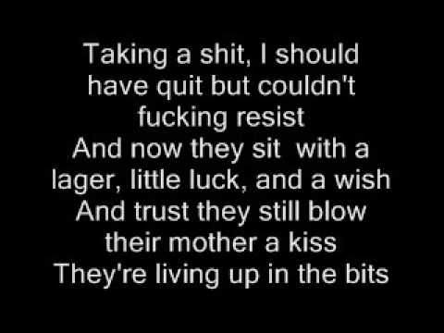
Song 2: Ain't Nothing Changed by Loyle Carner

Slide 6
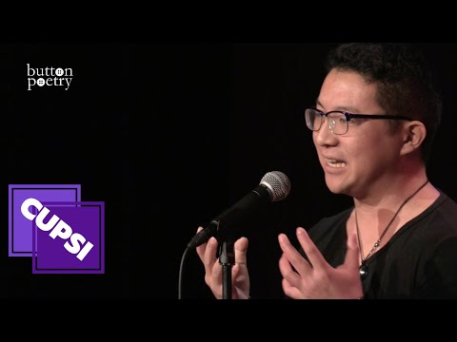
Poem 1: "Reasons Why I Hate Student Loans" by Slam poet Brian Yu

Slide 7
Poem 2: The Debt by Paul Laurence Dunbar
This is the debt I pay
Just for one riotous day,
Years of regret and grief,
Sorrow without relief.
Pay it I will to the end —
Until the grave, my friend,
Gives me a true release —
Gives me the clasp of peace.
Slight was the thing I bought,
Small was the debt I thought,
Poor was the loan at best —
God! but the interest!

Slide 8
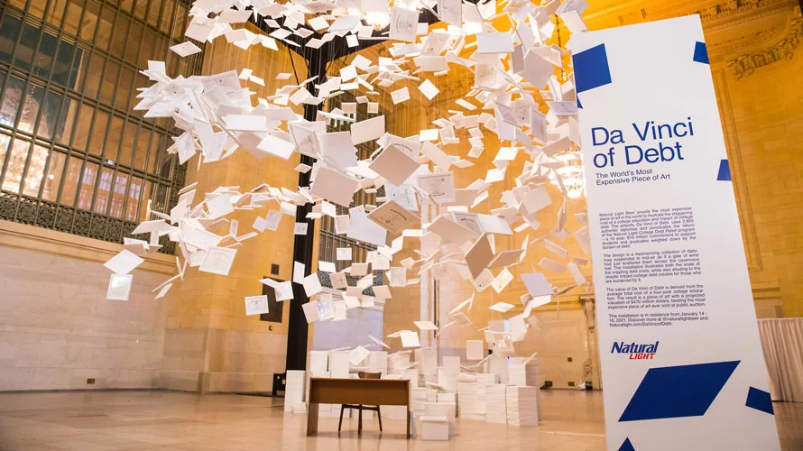
Artwork 1: Da Vinci of Debt by Natural Light

Slide 9
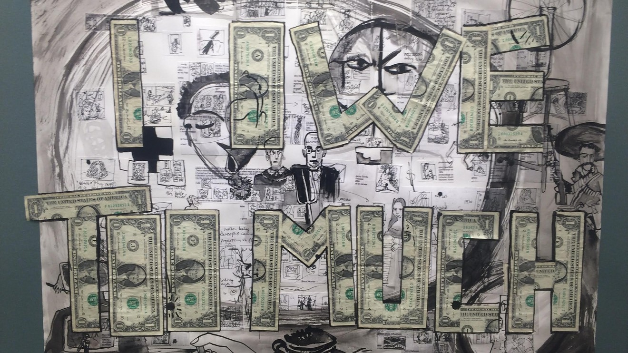
Artwork 2: I Owe Too Much by Jovanna Venegas

