Slide 1
Media Resources for Recycling
Videos, Songs, Poems, and Artwork

Slide 2
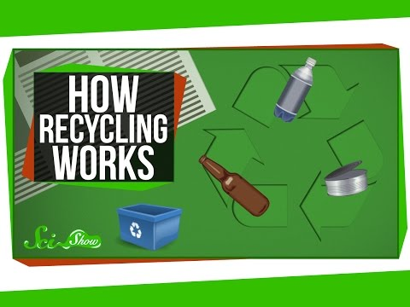
Video 1:How Recycling Works by SciShow

Slide 3
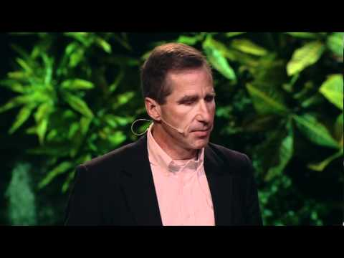
Video 2: We Can Recycle Plastic by Mike Biddle

Slide 4
Song 1:The 3 R's by Jack Johnson

Slide 5
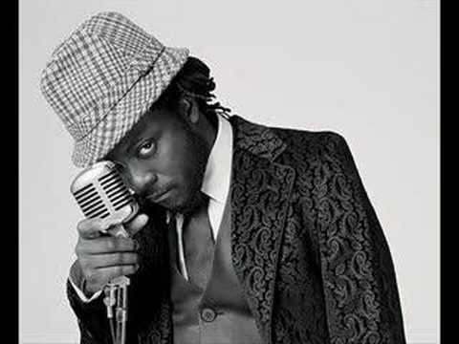
Song 2: S.O.S. (Mother Nature) by Will.I.Am

Slide 6
Poem 1: This Is Art, Not Trash II by Mirakysriftqa
Just walking along the University Avenue
and in one of those creekside shrubberies,
saw a discarded drink bottle, scrunched into a broken plastic cup. I snapped a picture.
A station slowly spins in the void,
solar panels extended at one section,
its hull ribbed with docking modules.
Myriad smaller vessels flow upon and
around the behemoth while beyond,
behind it, pulses a magenta nebula.
I shoved aside a pang of guilt for leaving this trash where it was. I had elsewhere to be.

Slide 7
Poem 2: Recycling Center by Brenda Hillman
The labeled bins on the California hillside
catch the glint and quarter-glint of passing cars.
Families pull up with their interesting trash
and start unloading: Here, sweetheart,
this goes over in Newspaper. The bundle
hits with a thud. Diet soda cans
spin almost noiselessly down, and the sun-
permitting bottles from a day’s pleasure
are tossed into Mixed Glass by the children
who like to hear the smash, unknowable, chaotic,
as matter greets itself and starts to change.

Slide 8
What mystery is inside a thing! If we peered
into the bin, we could see it waiting there,
could believe everything is alive and specific
and personal, could tell by the tilt of one
bottle against the next that it’s difficult
to be singular, to have identity, to keep
an outline safe in the terrors of space.
Even the child knows this. Bye, bottle! she shouts,
tossing it in; and the bottle lies there
in the two o’clock position, temporarily itself,
before being swept into the destiny of mixture. . .
And what if some don’t want to. What if some items
in the piles of paper, the orange and blue
envelopes from a magazine sweepstakes, numbers
pressing through the cloudy windows
with our names, some among those pale sheets curled
with moisture, would rather stay as they are.
It’s spring; we’ve thrown away mistakes—
tax forms, recipes, tennis-ball-sized
drafts of poems—that which was blank
shall be made blank again—but what if
that failed letter wants to be a failure,
not go back to pulp, and thought .. .
Or across the parking lot, where light insists
on changing the dull cans, a few cans don’t want
to be changed, though they should want to,
shouldn’t they, should want to be changed
by light, light which is called sweet reason,
honeyed, spectra, magnitude, light that goes
from the parking lot looking helpless
though it is matter that has been betrayed. . .

Slide 9
All afternoon the bins are carried off
by those who know about where things should go,
who are used to the clatter the cans make,
pouring out; and the families, who believed change
would heal them are pulling away in their vans,
slightly embarrassed by that which refused . . .
The bins fill again with hard substances,
the hills bear down with their fugitive gold,
the pampas grass bending low to protect
what was briefly certain and alive with hope.

Slide 10
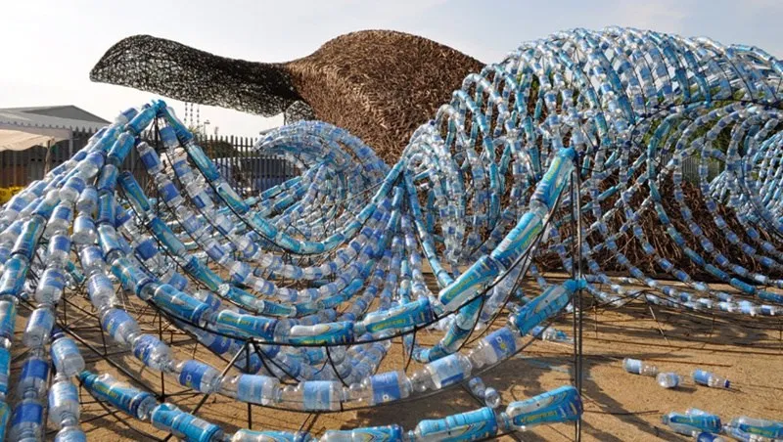
Artwork 1:
Bristol’s whales sculpture is made of willow and 70000 plastic bottles

Slide 11
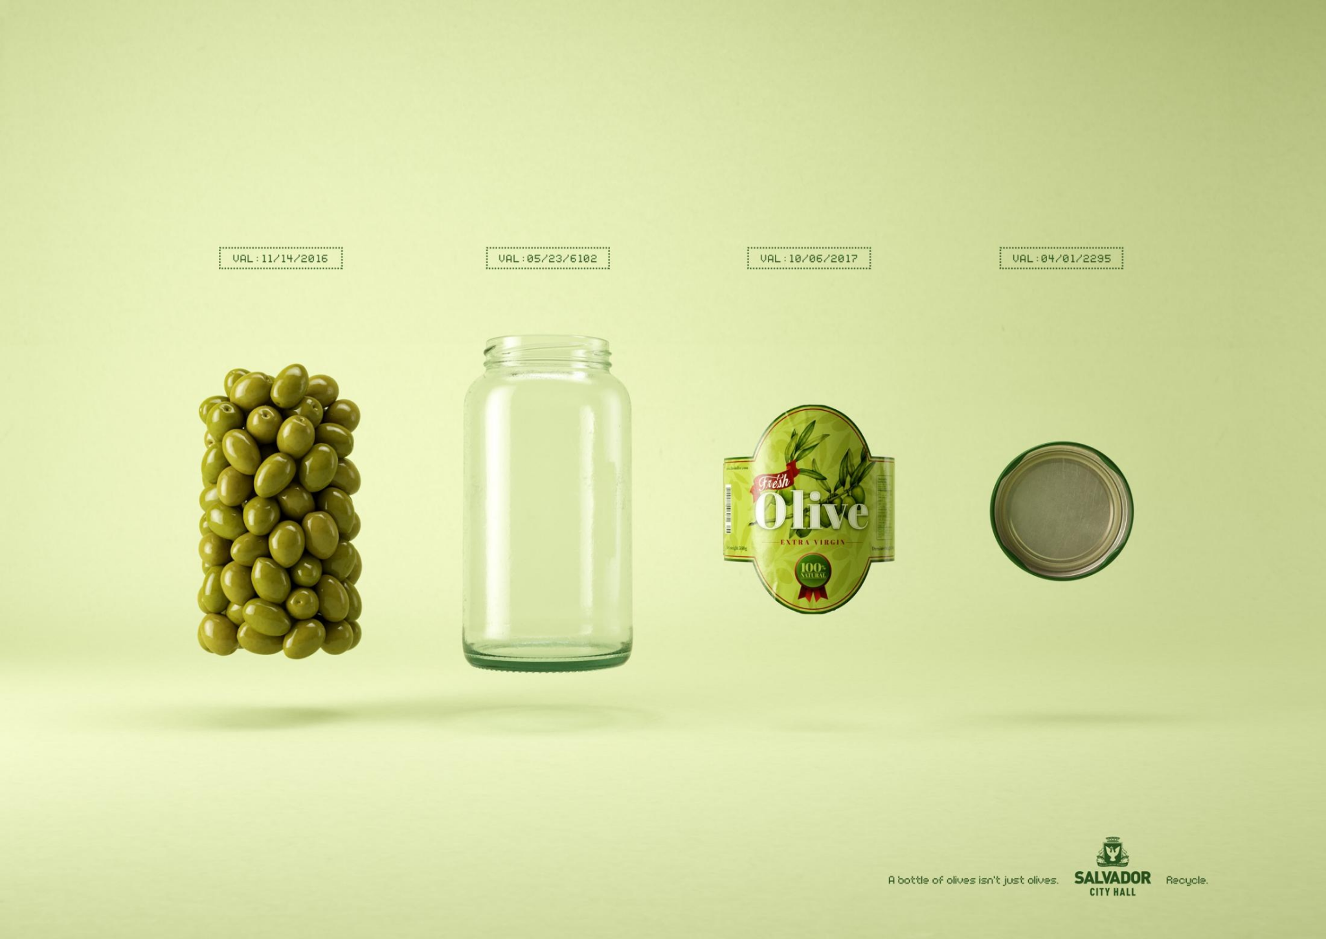
Artwork 2: Salvador City Hall Olives Campaign

