Slide 1

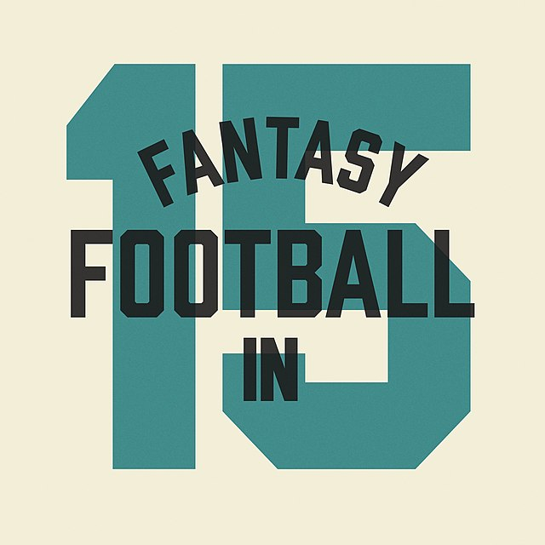
Fantasy Football
Virtual Community
Amy Minervini

Slide 2
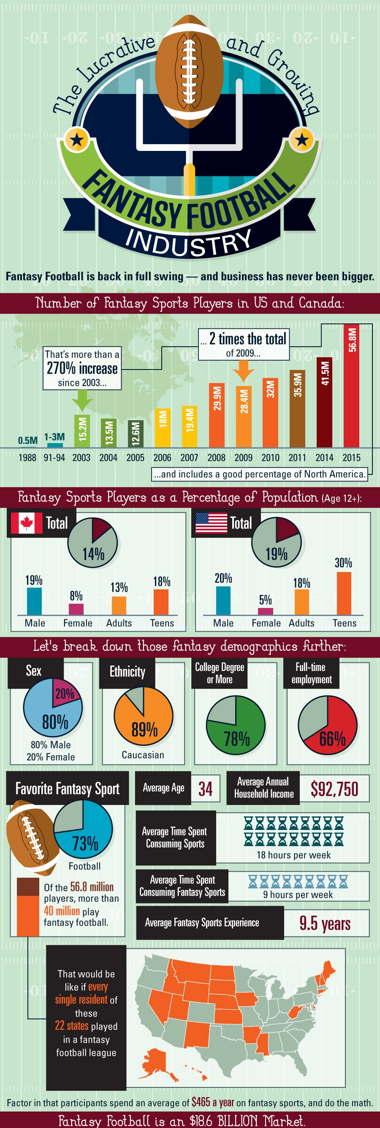
The who:
Of the 56.8 million fantasy sports players, more than 40 million play fantasy football each year.
While there are also professional players who do this as their career, it’s mostly everyday people like you and me who compete.

Slide 3
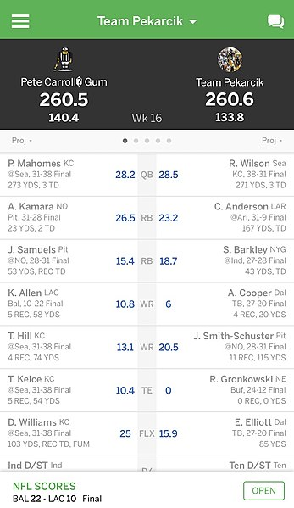
The why:
I get to compete against friends/family or with strangers as I draft players from various nfl teams. I put my best players forward each week in a head-to-head challenge.
Players making it to the championship weeks can earn money and/or bragging rights. I earn hundreds of dollars each season from placing in the top three of the various leagues I’m in. I’ve been in some leagues for years, having never personally met the other managers I play with but still connecting through gamesmanship.

Slide 4
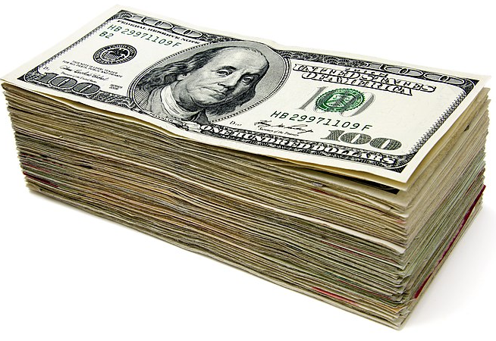
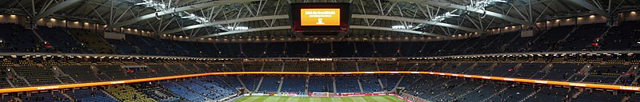
Why these are my people:
Fantasy Football gives managers (i.e. the players like me who play the game):
A sense of camaraderie and community
Competition (friendly or fierce)
Honed research skills on players, positions, historical data, & statistical predictions
Expanded love, fandom, &/or respect for teams other than your favorite or ‘hometown’ team
Luck—some weeks you have it; some you don’t. Just have to roll with the wins and losses
Ego boost or money—some leagues are played just for fun while others have a bankroll at stake. I play in both types, allowing me to hone my drafting/managing skills

Slide 5
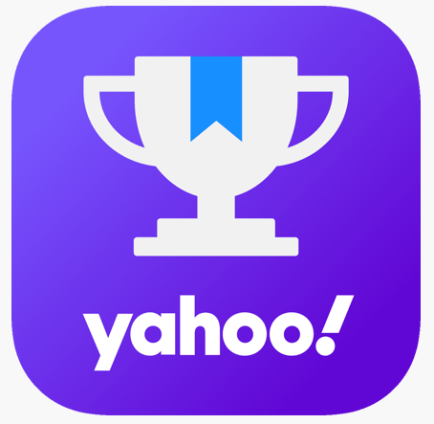
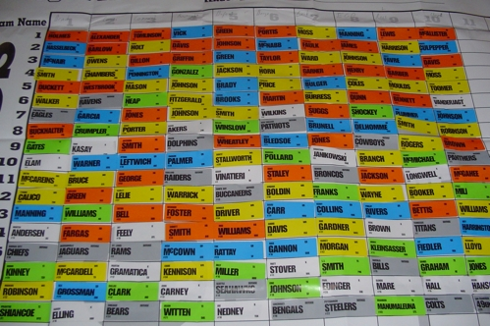
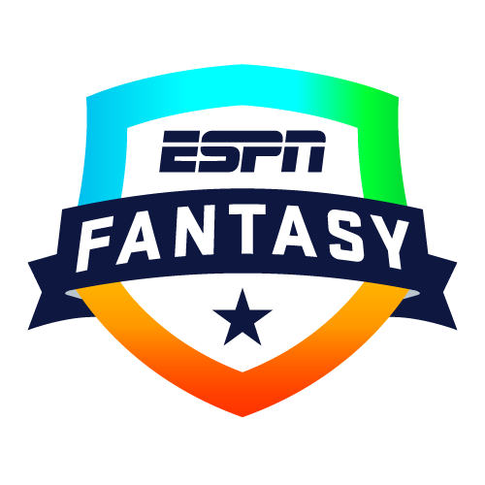
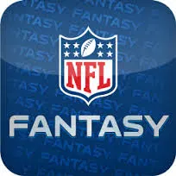
The where & how:
- online platforms with mobile apps or via pen and paper
- + Lots of sites teach you how to play the game & increase skills

Slide 6

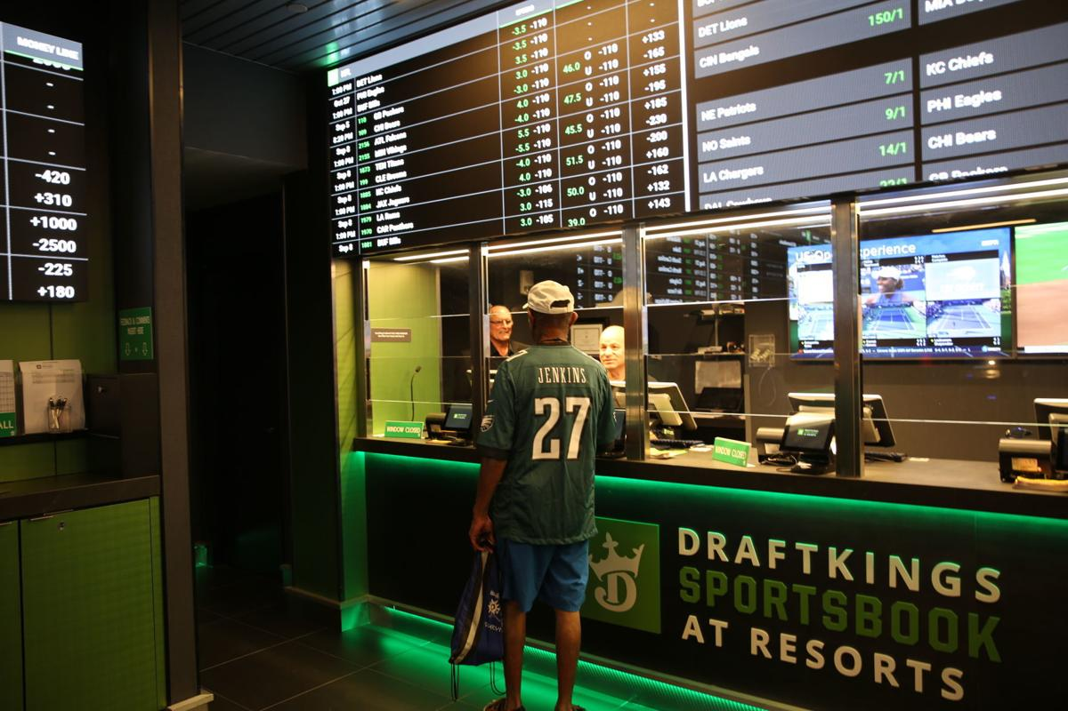
Fantasy football is fun, So what’s the problem?
Problem:
Sports betting is only legal in 18 states, and Idaho is not one of them. States often see sports betting as a form of gambling and illicit behavior. Both online and land-based sports betting is illegal in Idaho.
Right now, Fantasy Football can only be played recreationally in Idaho, and technically betting on sports isn’t legal yet still happens on the sly.
Solution:
If online betting houses like Draft Kings or Fan Duel are not allowed nor land-based bookkeepers sanctioned by the state, then allow sports betting to happen on Native American Reservations, where tribal leaders who seek to expand their casino business could profit. Indigenous groups who support sports betting on reservations want to retain exclusive rights to operate sports betting and keep those revenues in turn helping their communities.
Reasons to make sports betting legal in Idaho:
Regulated betting means people pay taxes on their winnings/there is less chance of fraud
If allowed, It can bring in millions of dollars to a state.
When not allowed, people will travel to other states (often neighboring states, like Oregon) to do sports betting, taking $ out of Idaho
Folks are capable of self-control.

Slide 7
Works Cited
Andrew Magill from Boulder, USA, CC BY 2.0 <https://creativecommons.org/licenses/by/2.0>, via Wikimedia Commons
The Athletic Media Company, Public domain, via Wikimedia Commons
Benpekarcik, CC BY-SA 4.0 <https://creativecommons.org/licenses/by-sa/4.0>, via Wikimedia Commons
ESPN Fantasy. Logo. n.d. Web. Accessed 11 Aug 2021.
Karnowski, Steve, and Geoff Mulvihill. "Across the U.S., Tribes Split on Sports Gambling, Influencing Legalization." Mcall.com, 9 Apr. 2019, www.mcall.com/business/mc-biz-sports-gambling-tribes- 20190409-euui6n2lmbf2jacnmnhftgcuce-story.html. Accessed 11 Aug. 2021.
NFL Fantasy. Logo. n.d. Web. Accessed 11 Aug 2021.
Nicceeo, CC BY-SA 3.0 <https://creativecommons.org/licenses/by-sa/3.0>, via Wikimedia Commons
Norton, Charles. "Why States Are Betting On Sports Gambling To Cover Budget Deficits." Forbes, 1 July 2020, www.forbes.com/sites/charlesnorton/2020/07/01/why-states-are-betting-on-sports- gambling-to-cover-budget-deficits/?sh=3e8996585255. Accessed 11 Aug. 2021.
Simanek, CC0, via Wikimedia Commons
Sports Management Degree Hub. "The Lucrative and Growing Fantasy Football Industry." Sports Management Degree Hub, 26 Apr. 2021, www.sportsmanagementdegreehub.com/fantasy-football-industry/.
Yahoo! Fantasy. Logo. n.d. Web. Accessed 11 Aug 2021.

