Slide 1

Saturday Morning Meals on Wheels Volunteer:
Lewiston, IDaho
Jennifer Anderson

Slide 2
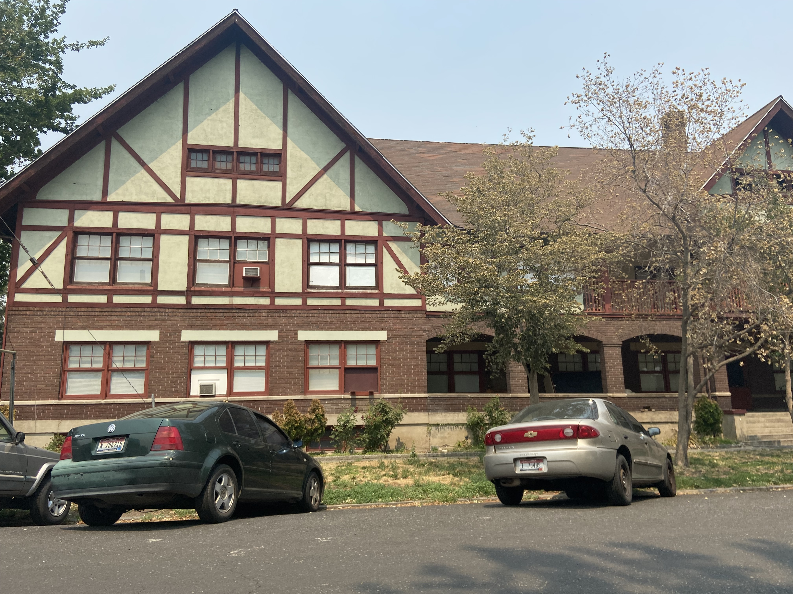
Did you know that 15% of Idaho senior citizens are threatened by hunger, and that 40% of Idaho’s most vulnerable seniors live alone?
Statistics: Meals on Wheels America. “Delivering So Much More Than a Meal in Idaho” Fact Sheet. Sep 2020.

Slide 3
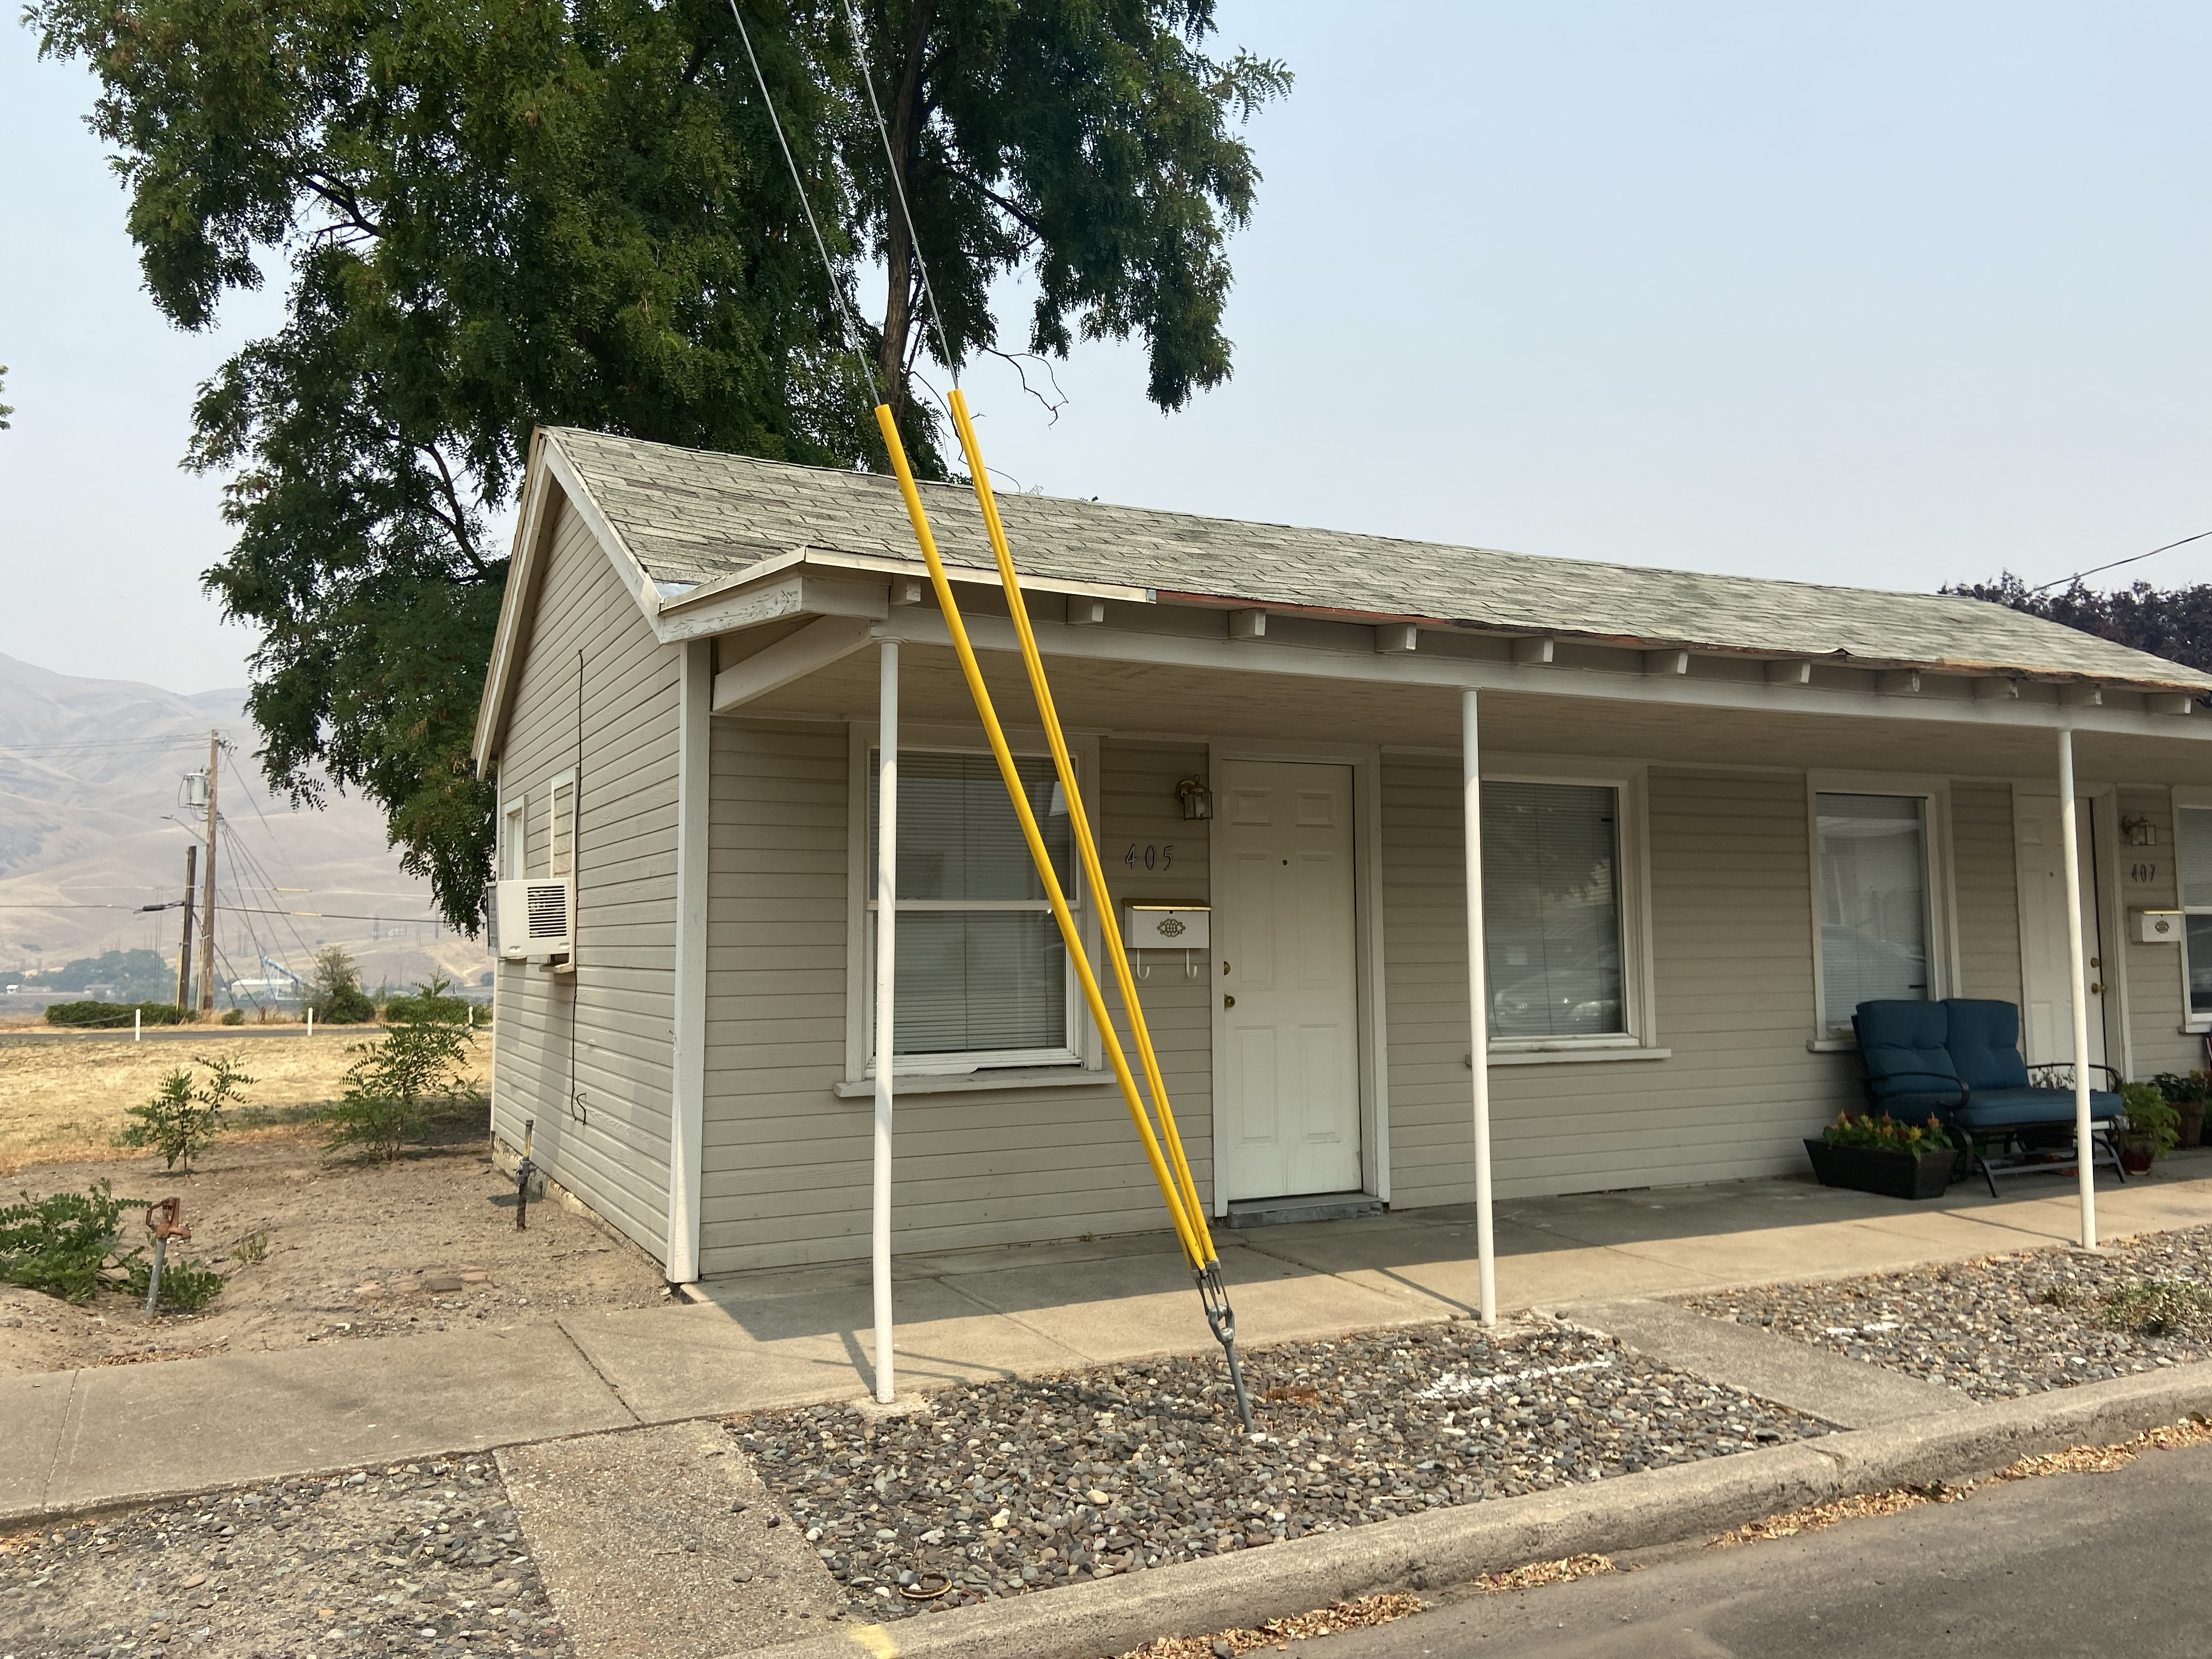
For some food recipients, this is the only meal they will have that day.

Slide 4
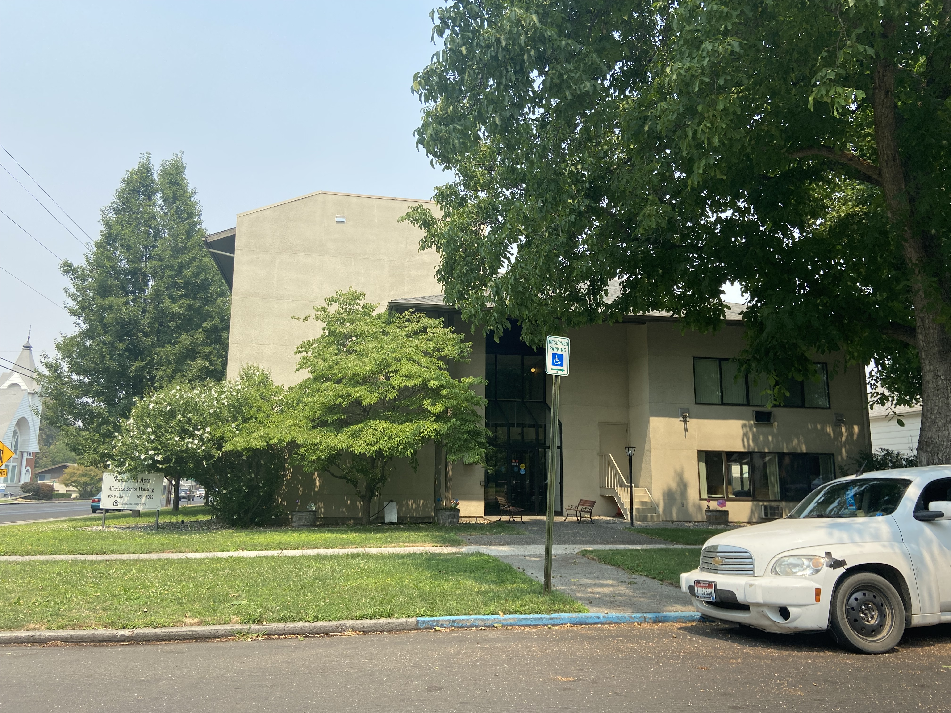
For others, the person delivering the meal is the only person they will see that day.

Slide 5
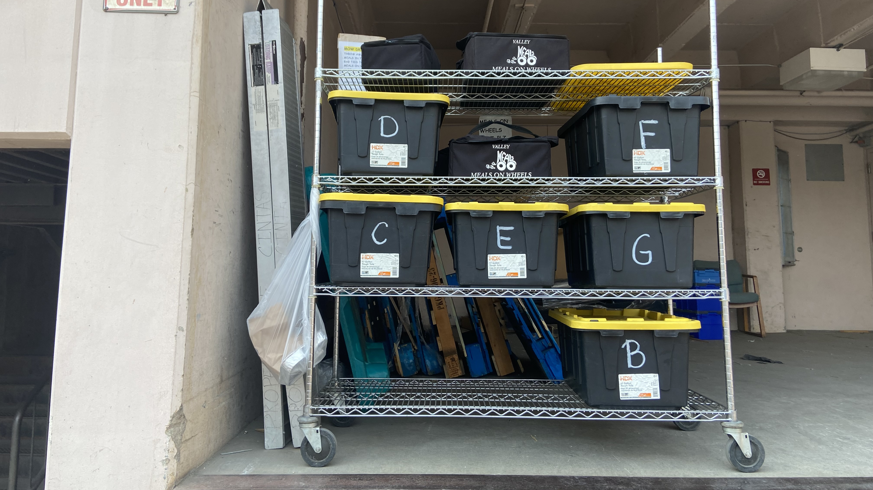
Each volunteer is assigned a specific route. We meet at the hospital loading dock to pick up meals for delivery.

Slide 6
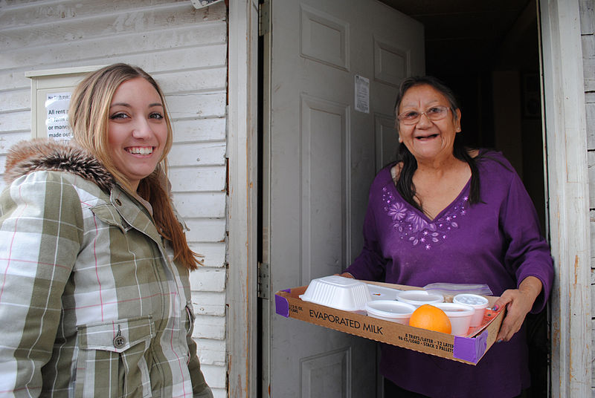
Some meal recipients meet us at their door.
Photo credit: "File:Meals on Wheels delivery.jpg."

Slide 7
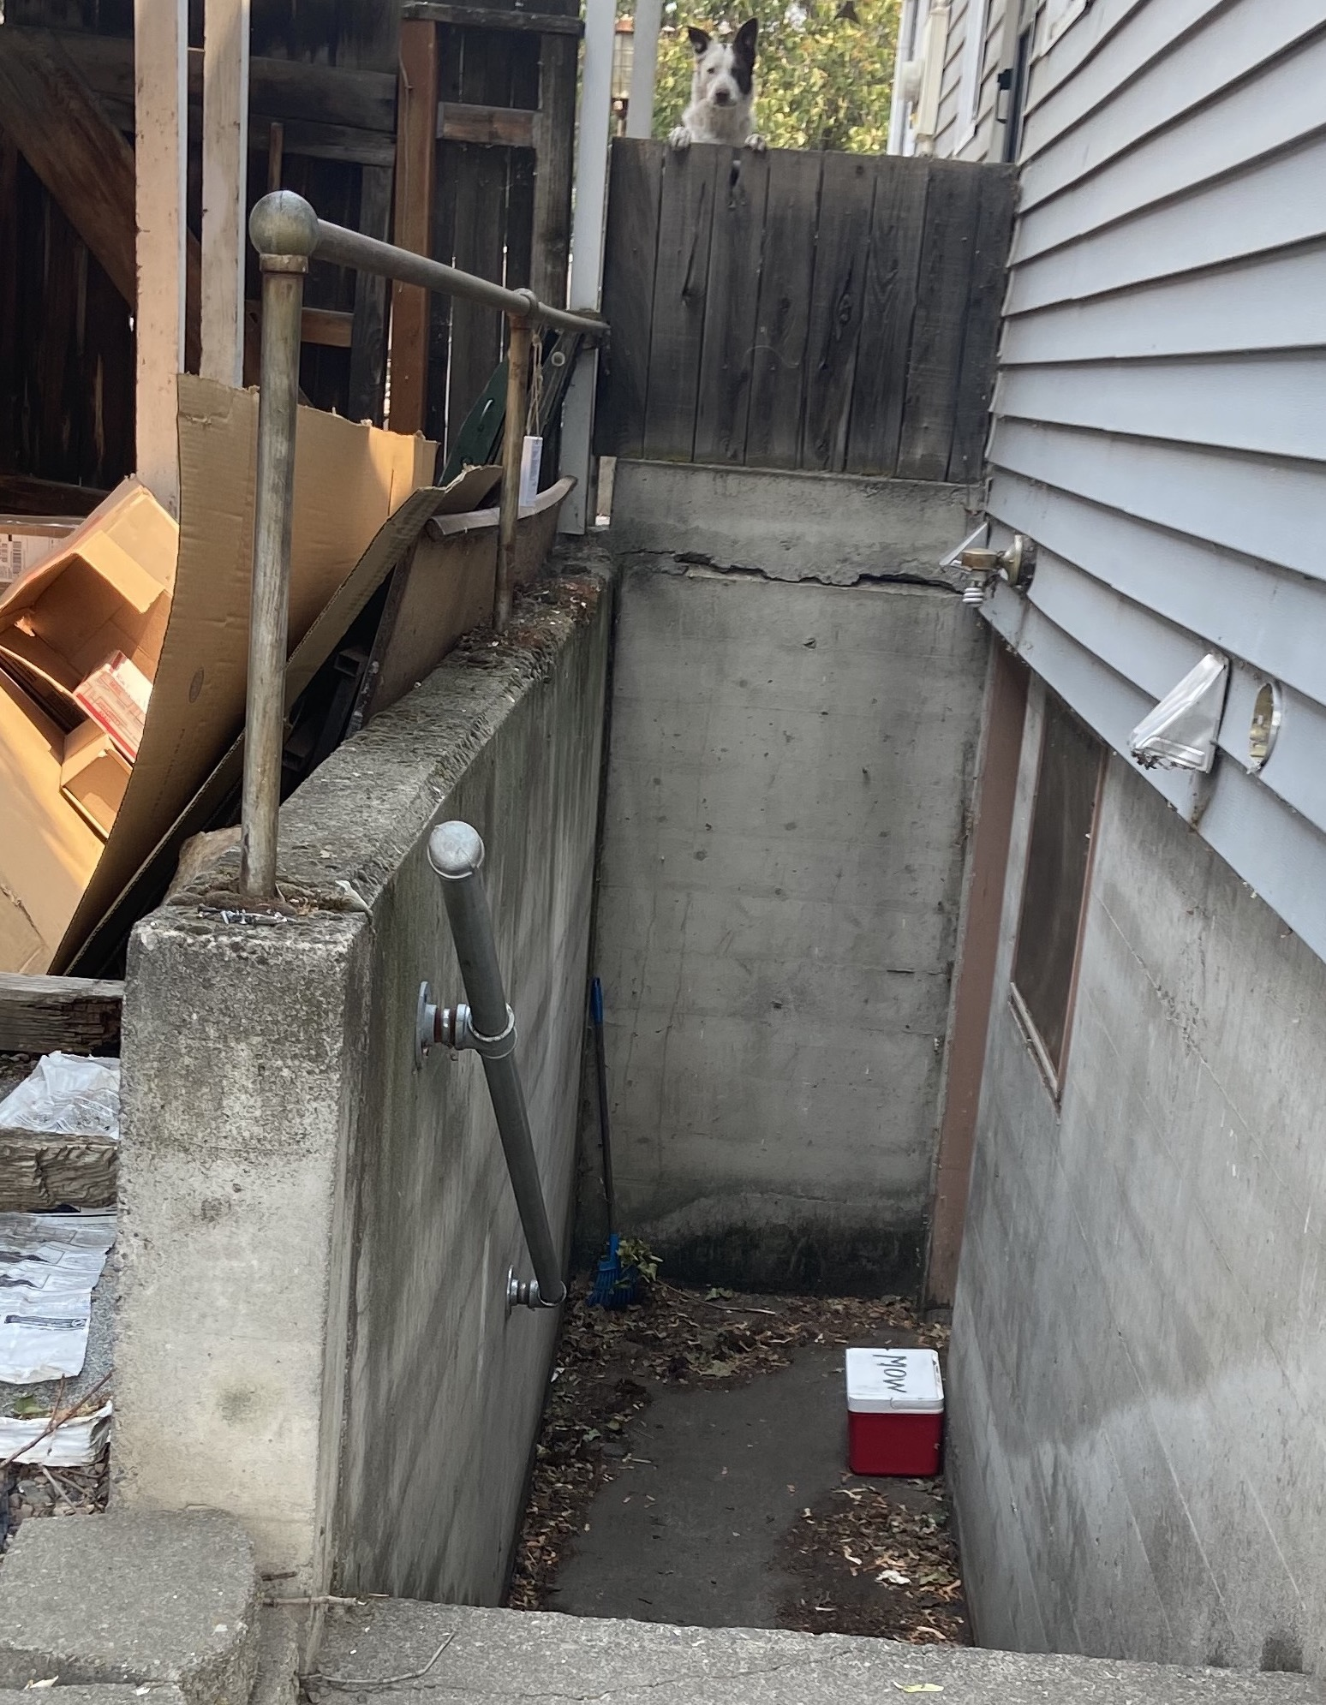
Others leave us a red Meals on Wheels cooler outside.

Slide 8

Drivers Needed!
Volunteers deliver meals 365 days a year.
The Lewis-Clark Valley Meals on Wheels organization is always looking for drivers, especially substitutes to work weekends and in another driver’s absence.
It only takes an hour to an hour and a half once a week to make a huge difference!
Image credit: “Meals on Wheels,” Center for Learning in Action: Williams College

Slide 9
Works Cited
Center for Learning in Action. Meals on Wheels Logo. 2021. Williams College. learning-in- action.williams.edu/files/meals-on-wheels.gif. Accessed 13 Jul 2021.
“Delivering So Much More Than a Meal in Idaho” Fact Sheet. Meals on Wheels America. Sep 2020. https://www.mealsonwheelsamerica.org/docs/default-source/fact-sheets/2020/2020-state/idaho- 2020.pdf?sfvrsn=a8a9b53b_2. Accessed 13 Jul 2021.
Wikimedia Commons, the Free Media Repository. File:Meals on Wheels delivery.jpg. 24 Sep 2020. https://commons.wikimedia.org/w/index.php?title=File:Meals_on_Wheels_delivery.jpg&oldid=469571133. Accessed 13 Jul 2021.

