Slide 1
Concept Development
Let loose–be creative!

Slide 3
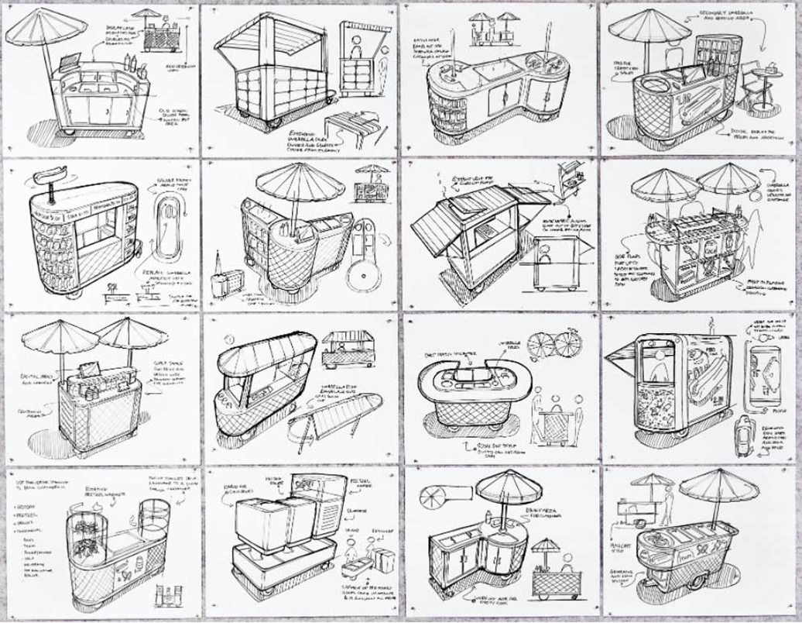

Slide 5
What are priorities? What will it solve?
Priorities:
What are three things/elements that you are prioritizing?
Can elements be combined? If so, which ones?
Purpose:
Will the concept address the problem partially or the whole thing?
What will it solve?
What else can it solve or help with?

Slide 6
Examples of Priorities:
Target audience/stakeholder/user
Ease of use
Affordability—cost to use
Easy access
Accessibility--ADA
Reaching specific communities
Materials
Cost to make
Sustainability—can this last?
Location
Space needed
Marketing the idea
Buy-in/Participation—will people actually do it?
Environmentally-friendly
Can this idea be scaled up?
Aesthetics
Specificity of information

Slide 7
Time to Design!
Use ideas you wrote down from the previous 2 slides to create 2 to 3 concepts for each of your two Prototype Ideas, mimicking the process we went through for the hot dog cart.
Draw or write these ideas down–annotate (if time allows) with important elements/aspects that you want to showcase.
You should have 6 concepts by the end of the class.

